Slide 1
Exception Handling
An exception is a run-time error.
Unless an exception is properly handled, it is likely to result in abnormal program termination and potential loss of work.
For example, an undetected division by zero or dereferencing of an invalid pointer will almost certainly terminate the program abruptly.
Exception handling consists of three things:
(i) the detecting of a run-time error,
(ii) raising an exception in response to the error, and
(iii) taking corrective action (recovery)

Slide 2
Exception Handling
C++ provides a language facility for the uniform handling of exceptions.
A section of code whose execution may lead to run-time errors is labeled as a try block.
Any fragment of code activated during the execution of a try block can raise an exception using a throw clause. All exceptions are typed (i.e., each exception is denoted by an object of a specific type).
A try block is followed by one or more catch clauses. Each catch clause is responsible for the handling of exceptions of a particular type.
When an exception is raised, its type is compared against the catch clauses following it. If a matching clause is found then its handler is executed. Otherwise, the exception is propagated up, to an immediately enclosing try block (if any). The process is repeated until either the exception is handled by a matching catch clause or it is handled by a default handler

Slide 3
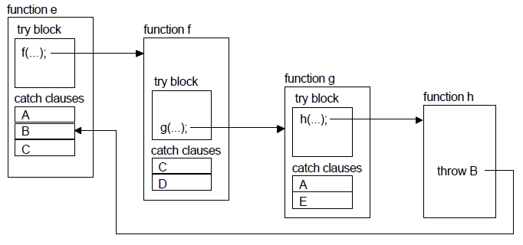
Flow Control in Exception Handling
After propagating the exception up flow of control is transferred from where the exception was raised in h to the matching catch clause in e.
The intervening stack frames for h, g, and f are unwound: all automatic objects created by these functions are properly destroyed by implicit calls to their destructors.
once an exception is raised and handled by a matching catch clause, the flow of control is not returned to where the exception was raised. The best that the program can do is to re-attempt the code that resulted in the exception (e.g., call f again in the above example).
If no exception is raised during the execution of a try block, then the catch clauses following it are simply ignored.

Slide 4
Exception Handling Clauses
throw clause
An exception is raised by a throw clause, which has the general form
throw object;
where object is an object of a built-in or user-defined type.
try Block and catch Clauses
A code fragment whose execution may potentially raise exceptions is enclosed by a try block, which has the general form
try {
statements
}
A try block is followed by catch clauses for the exceptions which may be raised during the execution of the block. The role of the catch clauses is to handle the respective exceptions. A catch clause (also called a handler) has the general
form
catch (type par) { statements }
where type is the type of the object raised by the matching exception, par is
optional and is an identifier bound to the object raised by the exception.

Slide 5
Exception Handling clauses …
A catch clause (of type C) matches an exception (of type E) if:
C and E are the same type, or
One is a reference or constant of the other type, or
One is a non-private base class of the other type, or
Both are pointers and one can be converted to another by implicit type conversion rules.
The order of appearance of catch clauses is significant.
Care must be exercised to place the types which are likely to mask
other types last.
For example, the clause type void* will match any pointer and should therefore appear after other pointer type clauses:
try {
//...
}
catch (char*) {/*...*/}
catch (Point*) {/*...*/}
catch (void*) {/*...*/}
The special catch clause type catch (...) { /* ... */ } will match any exception type and if used, like a default case in a switch statement, should always appear last.

Slide 6
Exception Handling Clauses …
The statements in a catch clause can also throw exceptions. The case where the matched exception is to be propagated up can be signified by an empty throw:
catch (char*) {
//...
throw; // propagate up the exception
}
If no matching catch clause is found the predefined function terminate is called, which simply terminates the program.
This function has the following type:
typedef void (*TermFun)(void);
The default terminate function can be overridden by calling set_terminate
and passing the replacing function as its argument:
TermFun set_terminate(TermFun);
Set_terminate returns the previous setting.

Slide 7
Function throw lists
Specifying what exceptions a function may throw is a good programming practice that enables function users to quickly determine the list of exceptions that their code will have to handle.
A function prototype may be appended with a throw list for this purpose:
type function (parameters) throw (exceptions);
double divide(num1,num2) throw (DivByZero);
Void Sort (List list) throw ();
Should a function throw an exception which is not specified in its throw list, the predefined function unexpected is called. The default behavior of unexpected is to terminate the program.
This can be overridden by calling set_unexpected (which has the same signature as set_terminate) and passing the replacing function as its argument:
TermFun set_unexpected(TermFun);
As before, set_unexpected returns the previous setting.

